Slide 1

Database Lab 8
NULL and Subquery
Addendum
Dr. Jefferson Fong

Slide 2
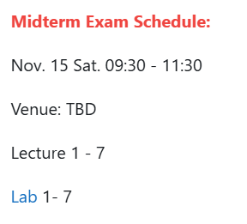
Announcements
Anyone who cannot attend at that time must apply for official excuse form in order to take the make-up test.
Closed book, no notes or any electronic devices allowed.
Bring a pen (or two) and your UIC or government issued photo ID card.

Slide 3
Announcement
Project
All requirements are in iSpace under “Project – Problem description”
  Check the Timeline section on when tasks are due.
ER diagram is due on Sunday 23 Nov 11:59 pm
Static Webpages (html files) are due Sunday 30 Nov 11:59 pm

Slide 4
Slide 3
In your sakila database, does table staff have the attribute staff_rating?
  Click table staff and see.
If staff_rating is missing, add it to table staff with these 2 queries from file Lab08_SakilaUpdate.txt
  Recall alter table in Lab 6.
  ALTER TABLE staff ADD staff_rating INT(11) DEFAULT NULL;
  Recall update in Lab 7; be careful with the quotes if you paste!
  UPDATE staff SET staff_rating = 10
  WHERE first_name=‘Mike’ AND last_name=‘Hillyer’;
  UPDATE staff SET staff_rating = NULL
  WHERE first_name=‘Jon’ AND last_name=‘Stephens’;
Click table staff to see if staff_rating has the correct values now.

Slide 5
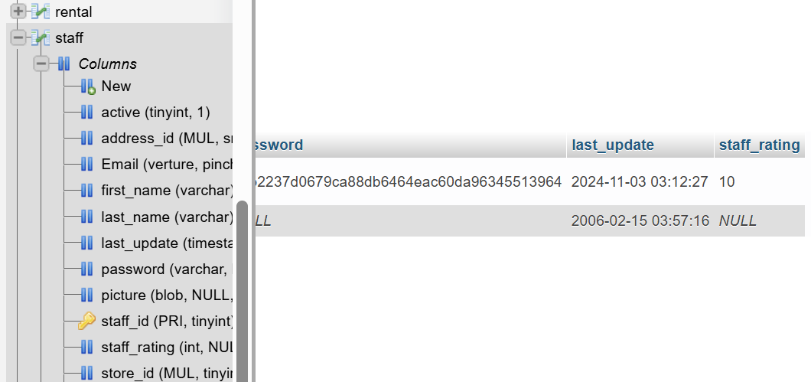
If correct, save a copy of the updated database.
  Click sakila > Export tab > Go
  Rename the download file to sakila_new.sql, and store it in your computer or memory stick, next to your old sakila.sql file.

Slide 6
Slide 4
Rules at top: Excel’s aggregation functions basically work the same way.
  E.g. at bottom: see RHS of last slide; one staff_rating is 10, another staff_rating is NULL.
  COUNT(), MIN(), etc. ignore all records with staff_rating NULL.
Slide 5
Comparison with NULL:
  If b is NULL, then b is evaluated as UNKNOWN in the comparison (b > 5)
  The expression (b > 5) is UNKNOWN because we don’t know the value of b.
    Can’t say whether b>5 is true or false; so b>5 is UNKNOWN.

Slide 7
Slide 6
If b is unknown, then
  (b OR true) = true
    Doesn’t matter whether b turned out to be true, false or unknown.
  (true AND b) = unknown
    If b turned out to be T, the total result is T, otherwise, the total result is F; we don’t know at this instance.

Slide 8
Slide 9
Do the subquery first.
SELECT film_id
FROM film
WHERE rating = 'PG-13’
  And store the result in the table temp.
Then do the main query.
SELECT actor_id
FROM film_actor NATURAL JOIN temp
Check the tables film and film_actor.
Run the subquery first. Then predict the result when you run the main query.
Slide 10: Using JOIN, we might create lots of extra data
  Recall Lecture 8 slide 7 on fake data.

Slide 9
Slide 12
Walk the tables first. Check the tables in sakila.sql
Exercise 1 (c.f. Lab 4 Exercise 1)
Actor(actor_id, first_name, last_name)
Film_actor(actor_id, film_id)
Film(film_id, title)
Exercise 2 (c.f. Lab 4, Exercise 2)
Customer(customer_id, first_name, last_name)
Rental(customer_id, inventory_id)
Inventory(inventory_id, film_id)
Film(film_id, title)

Slide 10
Slide 12
Exercise 6
C.f. Lab 5 Aggregations
Customer(customer_id, first_name, last_name)
Rental(customer_id, rental_id)
If a customer has not rented any film, the rental_id is NULL.
Subquery
  Create a temp table showing customer_ID whose rental_id is NULL
  LEFT OUTER JOIN – keep records (rows) with NULL values.
Main query, COUNT the number of customer IDs in the temp table.

Slide 11


